Slide 1

PROJECT ON ARTIFICIAL INTELLIGENCE
WALL-E
~ KOUSHIK JAIN
~ KIRAN DHANAWADE
~ RUTIKA AMBURE

Slide 2

INTRODUCTION
It's software that carries out everyday tasks via voice command. It's brings AI and machine learning together to recognize our voice and do what we ask it. Voice assistant software can be found on smart speakers, smartwatches, mobile phones, tablets and other devices.
WALL-E is the name of our voice assistance. It acts as a personal/virtual assistance making you day-to-day life easier. It is easy to use and most importantly user-friendly. Anyone including disabled and non techsavy people can use WALL-E as long as hey can speak.

Slide 3
BENEFITS
1) They Can Speak Multiple Languages:
You don’t have to worry about what language you’re speaking. Voice assistants understand a variety of languages and make communicating much easier for workers and make them much more productive than ever before.
2) They are Easy to Use with GPS Tracker Software:
GPS tracking software is great for keeping employees accountable by knowing where they are at all times. These GPS time tracker programs work seamlessly with voice assistant tools, making it even easier to monitor your team members.
3) They Provide Instant Access to Information:
By using a voice assistant, you can get access to information without having to search through your phone. This saves time and allows for more engagement with colleagues as opposed to being on your phone all day.
4) Easy to Manage Timesheet with Voice Assistant:
We often hear that our customers love how easy their employees find their paperless time tracker to manage their timesheets with voice assistants and that they would never go back to the manual method again!
5) We can Use Them Anywhere, Anytime:
People can use voice assistants as per their work needs anytime and anywhere. They don’t need to be at a desk or working with a computer to get help with things like emails, scheduling meetings, etc.

Slide 4
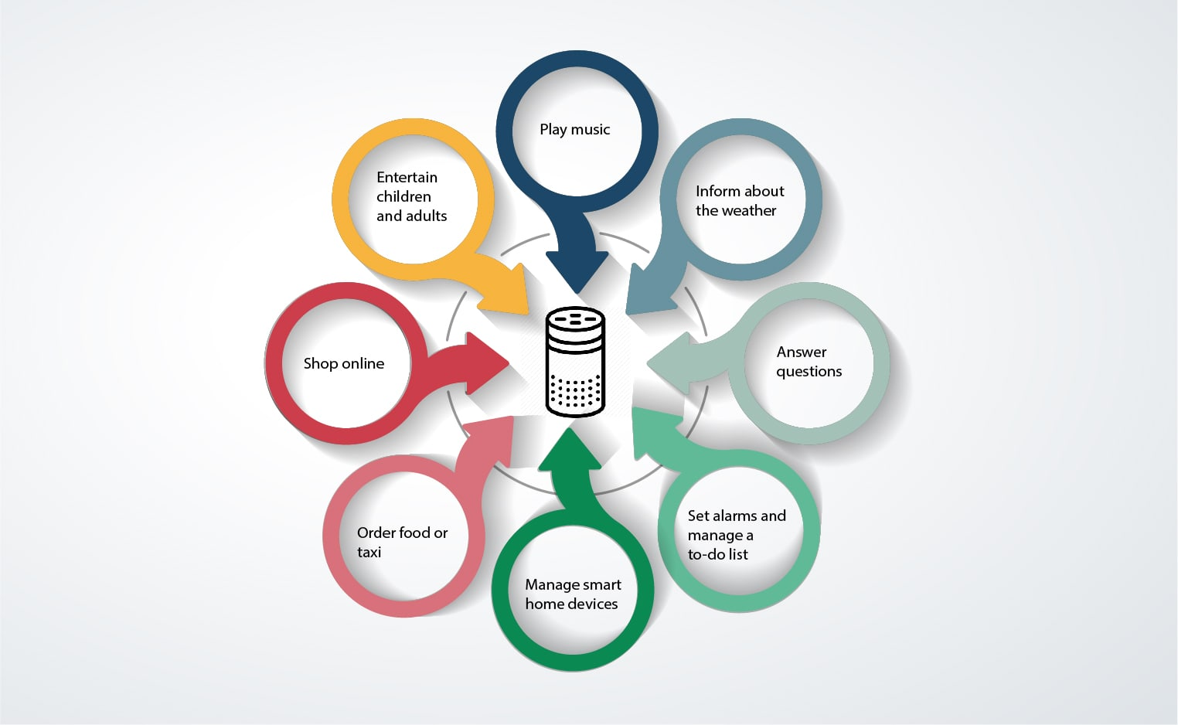
FEATURES
Speech-to-Text and Text-to-Speech conversion.
Search information about a certain topic.
Play Music.
Deliver a Joke.
Send an Email.
Find Places.
Provide Weather Update.
Acts as a Personal/Virtual Assistant

Slide 5
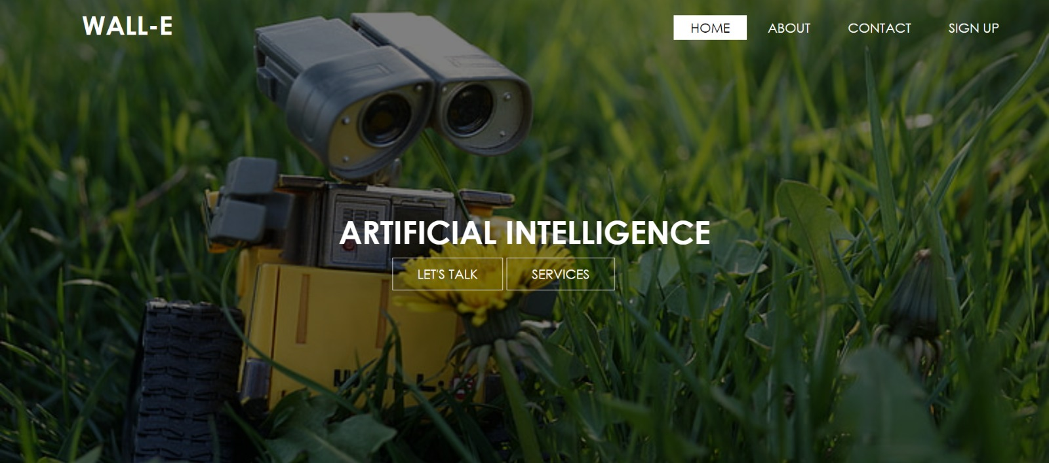
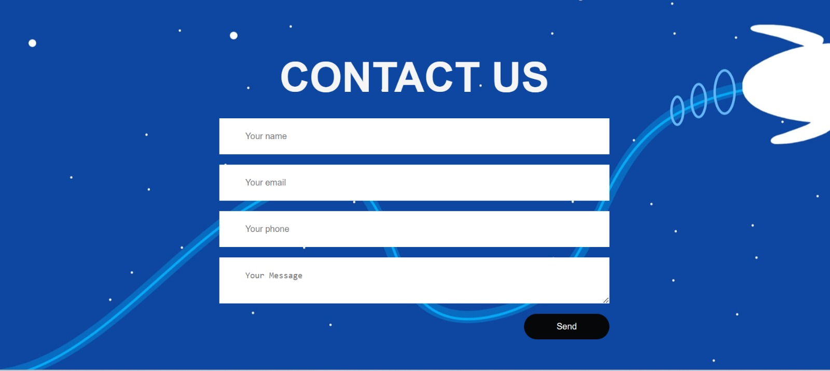
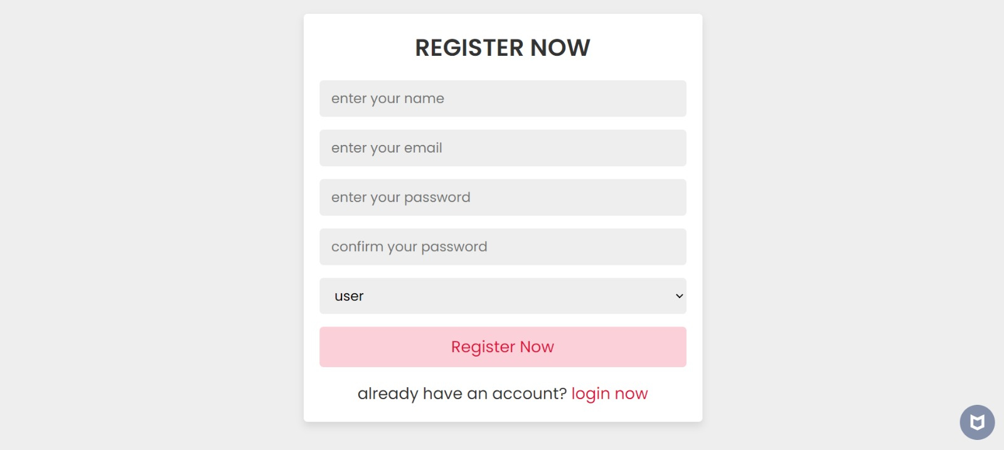

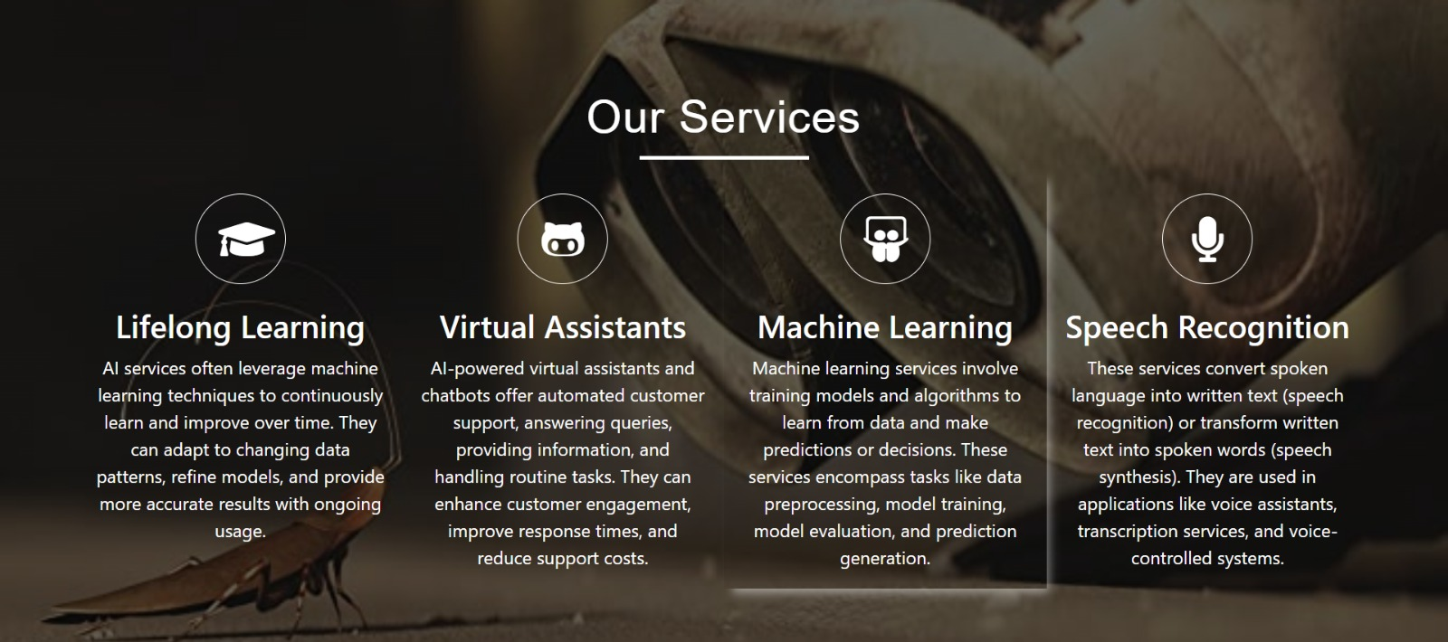
PHOTOS
Home Page
Contact Us Page
Registration Page
Login page
Services Info page

Slide 6

FUTURE
Five key predictions in voice assistants and AI tech
Streamlined conversations:
Google and Amazon recently announced that their voice assistants will stop requiring the user to say ‘wake’ words such as ‘Alexa’ or ‘Google’ to start a conversation. This new facility is making interacting with these assistants more natural for users—not to mention much more convenient. Such devices are also expected to get better at understanding contextual factors that make conversations more efficient.
2. Change in search behaviors:
The market value of Voice-based shopping will reach 40 billion by 2022, according to industry projections. · Consumer spending via voice assistants is also projected to reach 18% by the year 2022. · Not surprisingly by 2022, voice-based ad revenues are expected to reach $19 billion. The statistics show an unprecedented increase in voice searches on mobile devices. The primary way to gain visibility for most brands will still be organic search, but Amazon and Google will likely update their paid messaging platforms to cater to marketers, too. more natural for users—not to mention much more convenient. Such devices are also expected to get better at understanding contextual factors that make conversations more efficient.

Slide 7
3. Personalized experiences:
Digital assistants and voice-enabled devices such as Amazon’s Alexa and Google Home to let customers engage through speech—the most natural form of communication. Perhaps this is why voice-enabled devices saw 39% increase year-over-year in online sales. Pretty soon, voice assistants will start providing even more personalized experiences as they become better at distinguishing different voices and tailoring results according to each individual user’s information.
4. Compatibility and integration:
A wide range of products will likely integrate voice assistants in the near future. Samsung has already started this with its release of its Family Hub refrigerator. Google also recently rolled out a new product called Google Assistant Connect, which allows manufacturers to build custom devices integrated with this technology.
5. Focus on security:
Some 41% of voice device users claim that they are concerned about confidentiality while using their devices. This is why Amazon and Google introduced a number of security measures (including speaker ID and verification) to their voice assistant technologies. New solutions are also in the pipeline to make it more secure for customers to buy things using voice.

Slide 8
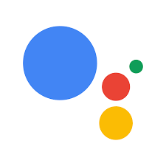



SIMILAR PRODUCTS
Google Assistant
Alexa
siri
Microsoft Cortana

Slide 9

CONCLUSION
Voice Assistance is now a permanent and growing industry. So, as we all know that today’s world has become too much competitive in all sorts of things. So, whether it be sports, studies, corporate world, etc. We are always in need of an innovative technology because, these technologies do help humans to ease 50 – 80 percent of work. Although the technologies are built by the humans itself but it tends to be more helpful in today’s world. So, keeping this thing in mind nowadays we all need to brush our knowledge daily to keep ourselves informative about stuffs going all around the globe. So, every day we learn something new in our life and it continues day by day.

